Slide 1
TOOL COMMAND LANGUAGE
CHETHAN KUMAR A C G15 VLSI FRONTEND

Slide 2
TCL Overview
Tcl stands for Tool Command Language.
Designed by John Ousterhout at the University of California, Berkeley.
Tcl was developed initially for Unix. It was then ported to Windows, DOS, OS/2, and Mac OSX.
It aims at providing ability for programs to interact with other programs.

Slide 3
Features of Tcl
Tcl stands for Tool Command Language.
Designed by John Ousterhout at the University of California, Berkeley.
Tcl was developed initially for Unix. It was then ported to Windows, DOS, OS/2, and Mac OSX.
It aims at providing ability for programs to interact with other programs.
Finally, it's an open source, free, and can be used for commercial applications without any limit.

Slide 4


Basic Synatx
The puts command in Tcl is used to output data to the console or a file.
Comments
Comments are like helping text in your Tcl program and the interpreter ignores them. Comments can be written using a hash_(#) sign in the beginning.

Slide 5
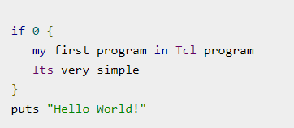
There is no multiple line comments inn TCL
Multiline or block comment is written using 'if' with condition '0'. An example is shown below.

Slide 6
Difference between {} and []
Curly Braces {}:
Used for grouping and quoting.
Treats everything inside the braces as a single string, preserving white spaces and preventing substitutions.
Commonly used for defining procedures, quoting strings, and grouping multiple commands.
set text {This is a string with special characters: $var}

Slide 7
Difference between {} and []
Square Brackets
Used for command substitution.
Executes the command inside the brackets and substitutes the result in place.
Often used to nest commands or capture the output of a command.
The command within the square brackets is executed, and its result is assigned to the variable or used in the expression.
set result [expr 2 + 2]

Slide 8


Variable Substitution
In variable substitutions, $ is used before the variable name and this returns the contents of the variable. A simple example to set a value to a variable and print it is shown below.
When the above code is executed, it produces the following result.
Data types
In Tcl, whether it is an integer number, boolean, floating point number, or a string. When you want to use a variable, you can directly assign a value to it, there is no step of declaration in Tcl. There can be internal representations for these different types of objects. It can transform one data-type to another when required.

Slide 9


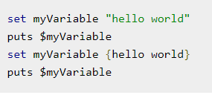

String Representations
Unlike other languages, in Tcl, you need not include double quotes when it's only a single word.
When we want to represent multiple strings, we can use either double quotes or curly braces.

Slide 10
Variable Naming
The name of variables can contain any characters and length. You can even have white spaces by enclosing the variable in curly braces, but it is not preferred.
Variable names in Tcl can consist of letters, digits, and underscores.
They must start with a letter or an underscore.
set myVar 42
set _counter 0
set userName "John“
Invalid variable names:
set 123var "Invalid" ;# starts with a digit
set my-Var "Invalid" ;# contains a hyphen

Slide 11
Operators
TCL contains the operators listed below
Arithmetic Operators
Relational Operators
Logical Operators
Bitwise Operators
Ternary Operator

Slide 12
Arithmetic Operators
Following table shows all the arithmetic operators supported by Tcl language. Assume variable ‘A’ holds 10 and variable ‘B’ holds 20, then
Operator | Description | Example
+ | Adds two operands | A + B will give 30
- | Subtracts second operand from the first | A - B will give -10
* | Multiplies both operands | A * B will give 200
/ | Divides numerator by de-numerator | B / A will give 2
% | Modulus Operator and remainder of after an integer division | B % A will give 0

Slide 13
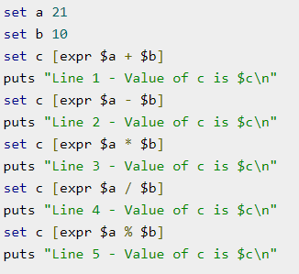
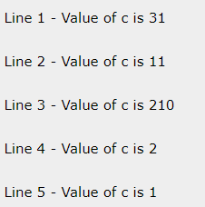
Arithmetic Operators

Slide 14
Relational Operators
Operator | Description | Example
== | Checks if the values of two operands are equal or not, if yes then condition becomes true. | (A == B) is not true.
!= | Checks if the values of two operands are equal or not, if values are not equal then condition becomes true. | (A != B) is true.
> | Checks if the value of left operand is greater than the value of right operand, if yes then condition becomes true. | (A > B) is not true.
< | Checks if the value of left operand is less than the value of right operand, if yes then condition becomes true. | (A < B) is true.

Slide 15
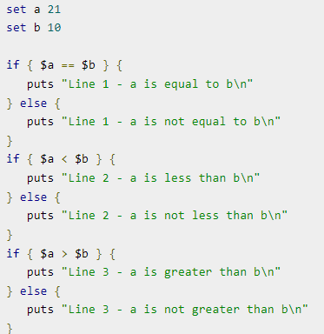
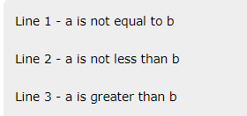
Relational Operators

Slide 16
Logical Operators
Following table shows all the logical operators supported by Tcl language. Assume variable A holds 1 and variable B holds 0, then
Operator | Description | Example
&& | Called Logical AND operator. If both the operands are non-zero, then condition becomes true. | (A && B) is false.
|| | Called Logical OR Operator. If any of the two operands is non-zero, then condition becomes true. | (A || B) is true.
! | Called Logical NOT Operator. Use to reverses the logical state of its operand. If a condition is true then Logical NOT operator will make false. | !(A && B) is true.

Slide 17
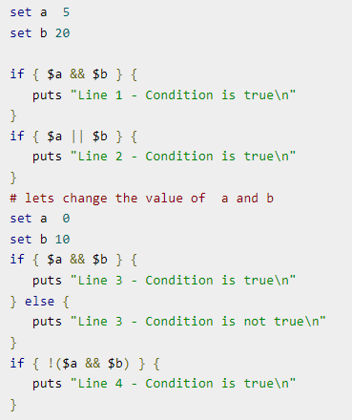
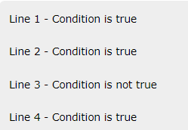
Logical Operators

Slide 18
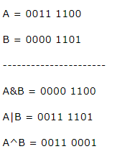
Bitwise Operators
Bitwise operator works on bits and perform bit-by-bit operation. The truth tables for &, |, and ^ are as follows
p | q | p & q | p | q | p ^ q
0 | 0 | 0 | 0 | 0
0 | 1 | 0 | 1 | 1
1 | 1 | 1 | 1 | 0
1 | 0 | 0 | 1 | 1

Slide 19
Ternary Operator
Operator | Description | Example
? : | Ternary | If Condition is true? Then value X : Otherwise value Y
The ternary operator, also known as the conditional operator, is a concise way to express a conditional (if-else) statement in a single line of code.

Slide 20
Conditional Statements
If – Else block
if {condition} {
# code to execute if the condition is true
} elseif {another_condition} {
# code to execute if the first condition is false and this condition is true
} else {
# code to execute if all conditions are false
}

Slide 21
Switch Block
Tcl also supports the "switch" statement, which allows for multi-way branching based on the value of a variable or expression. It provides a concise way to handle multiple possible cases.
switch $variable {
value1 {
# code to execute for the first case
}
value2 {
# code to execute for the second case
}
default {
# code to execute if none of the cases match
}
}

Slide 22
Loops
While Loop:
The "while" loop repeatedly executes a block of code as long as a specified condition is true. The syntax is as follows:
while {condition} {
# code to execute while the condition is true
}
For Loop:
The "for" loop is used for iterating a specific number of times. It has a flexible syntax and can iterate over a range of values or elements in a list. Here's a basic example:
for {set i 0} {$i < 5} {incr i} {
# code to execute for each iteration
}

Slide 23
LOOPS
Foreach Loop:
The "foreach" loop is specifically designed for iterating over elements in a list. It simplifies the process of looping through a collection. Here's an example
foreach item $list {
# code to execute for each item in the list
}

Slide 24
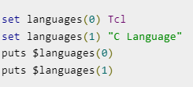

Arrays
An array is a systematic arrangement of a group of elements using indices.
set ArrayName(Index) value
An example for creating simple array is shown below.

Slide 25


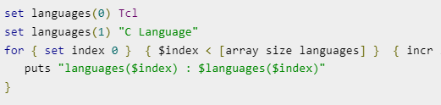

Size of Array
The syntax for calculating size array is shown below.
[array size variablename]
An example for printing the size is shown below.
Array Iteration :
we can use array iteration to access elements of the array.

Slide 26
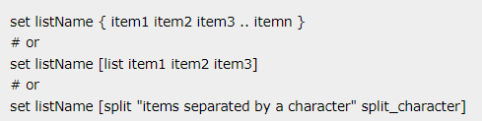
Lists
List is one of the basic data-type available in Tcl. It is used for representing an ordered collection of items. It can include different types of items in the same list. Further, a list can contain another list.
Creating a List

Slide 27
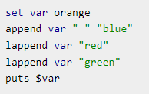

Some examples are given below
Appending Item to a List:
The syntax for appending item to a list is given below :
set colorList1 {red green blue}
set colorList2 [list red green blue]
set colorList3 [split "red_green_blue" _]
puts $colorList1
puts $colorList2
puts $colorList3
red green blue
red green blue
red green blue
append listName split_character value
# or
lappend listName value

Slide 28


Length of List :
The syntax for length of list is given below:
Example for length of list is given below
List Item at Index :
Example for list item at index is given below
llength listName

Slide 29
File I/O
Tcl supports file handling with the help of the built in commands open, read, puts, gets, and close.
A file represents a sequence of bytes, does not matter if it is a text file or binary file.
Sr.No. | Mode & Description
1 | r Opens an existing text file for reading purpose and the file must exist. This is the default mode used when no accessMode is specified.
2 | w Opens a text file for writing, if it does not exist, then a new file is created else existing file is truncated.
3 | a Opens a text file for writing in appending mode and file must exist. Here, your program will start appending content in the existing file content.
4 | r+ Opens a text file for reading and writing both. File must exist already.
5 | w+ Opens a text file for reading and writing both. It first truncate the file to zero length if it exists otherwise create the file if it does not exist.
6 | a+ Opens a text file for reading and writing both. It creates the file if it does not exist. The reading will start from the beginning, but writing can only be appended.

Slide 30
Opening Files
Tcl uses the open command to open files in Tcl. The syntax for opening a file is as follows −
open fileName accessMode
Closing a File
To close a file, use the close command.
close fileName
Reading a File
Following is the simple command to read from a file −
set file_data [read $fp]
Writing a File
Puts command is used to write to an open file.
puts $filename "text to write"

Slide 31
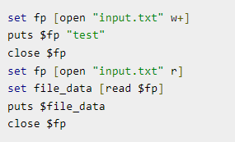
A complete example of read and write is shown below

Slide 32
Regular Expressions
The "regexp" command is used to match a regular expression in Tcl. A regular expression is a sequence of characters that contains a search pattern. It consists of multiple rules and the following table explains these rules and corresponding use.
Sr.No. | Rule & Description
1 | x Exact match.
2 | [a-z] Any lowercase letter from a-z.
3 | . Any character.
4 | ^ Beginning string should match.
5 | $ Ending string should match.

Slide 33
6 | \^ Backlash sequence to match special character ^.Similarly you can use for other characters.
7 | () Add the above sequences inside parenthesis to make a regular expression.
8 | x* Should match 0 or more occurrences of the preceding x.
9 | x+ Should match 1 or more occurrences of the preceding x.
10 | [a-z]? Should match 0 or 1 occurrence of the preceding x.
11 | {digit} Matches exactly digit occurrences of previous regex expression. Digit that contains 0-9.
12 | {digit,} Matches 3 or more digit occurrences of previous regex expression. Digit that contains 0-9.
13 | {digit1,digit2} Occurrences matches the range between digit1 and digit2 occurrences of previous regex expression.

Slide 34


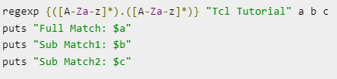

When this code is executed, it produces the following result
Multiple Patterns:
The following example shows how to search for multiple patterns. This is example pattern for any alphabets followed by any character followed by any alphabets.

Slide 35
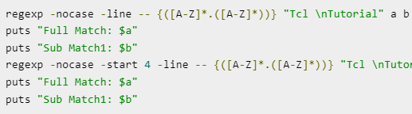
Switches for Regex Command
nocase − Used to ignore case.
indices − Store location of matched sub patterns instead of matched characters.
line − New line sensitive matching. Ignores the characters after newline.
start index − Sets the offset of start of search pattern.
Examples

